Slide 2
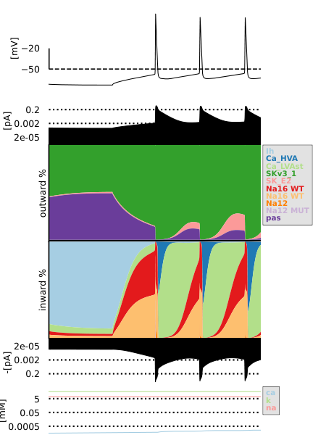
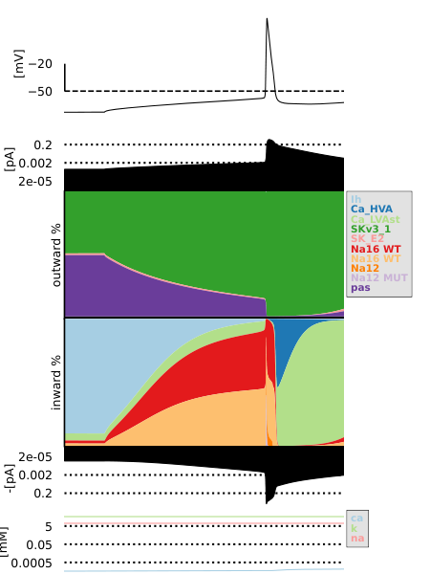
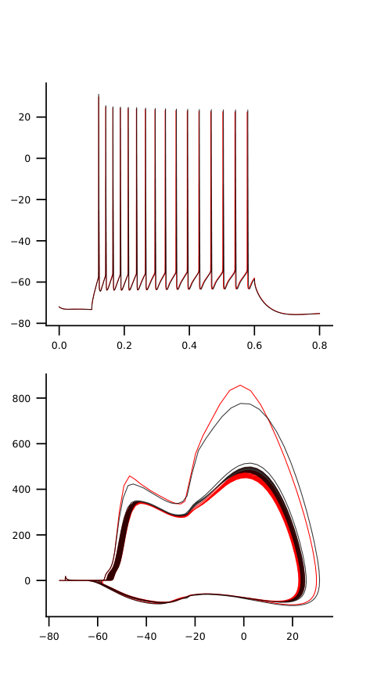
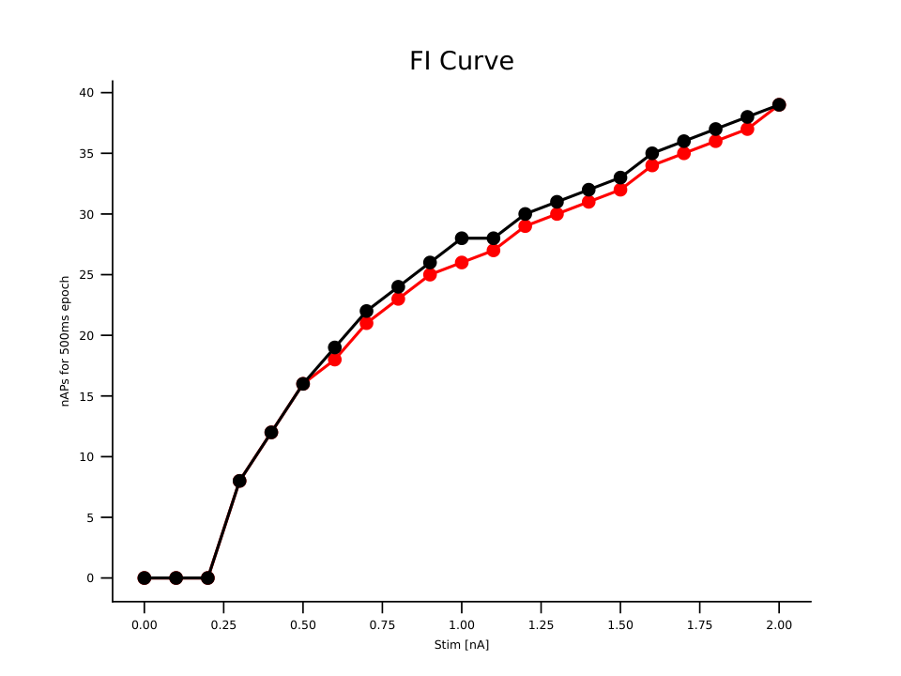
mut10_1_na12-1.75_na16-2

Slide 3


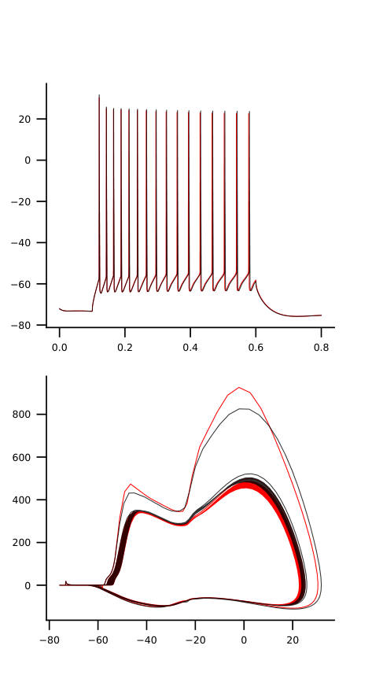

mut10_1_na12-2.0_na16-2

Slide 4


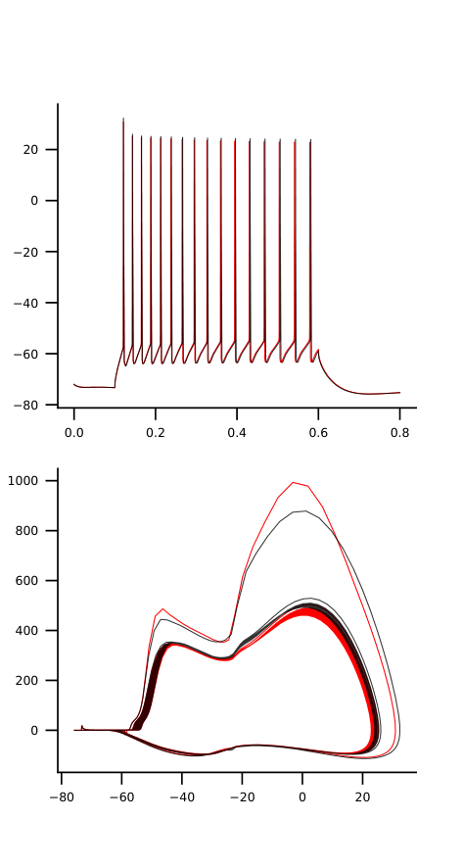

mut10_1_na12-2.25_na16-2

Slide 5


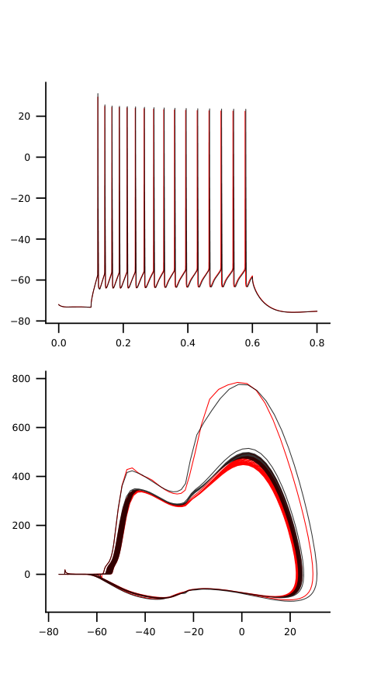
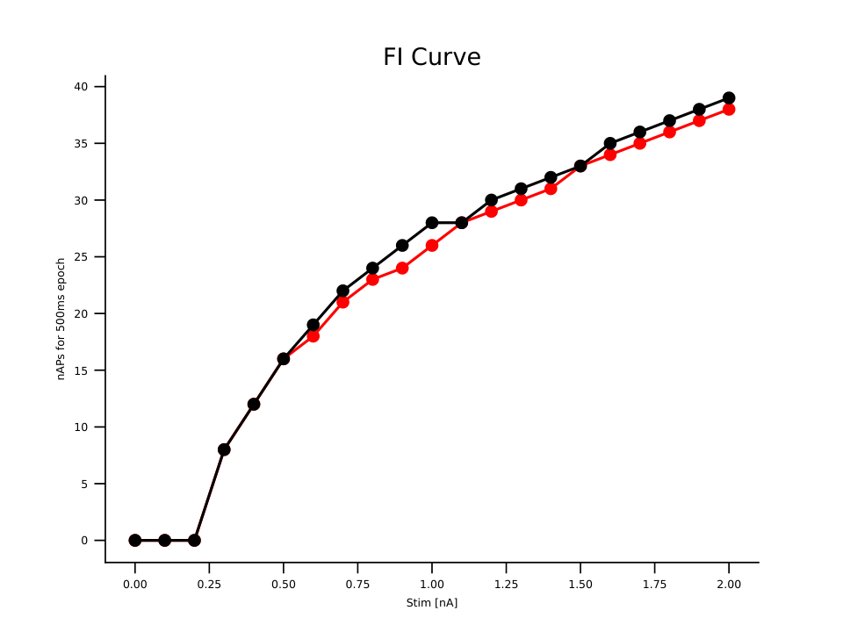
mut10_2_na12-1.75_na16-2

Slide 6


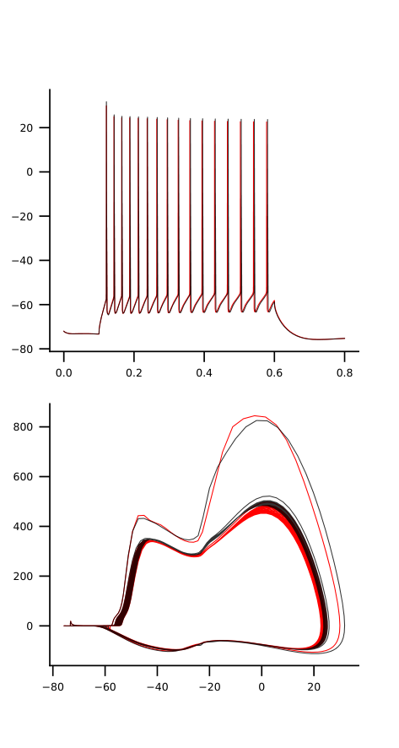
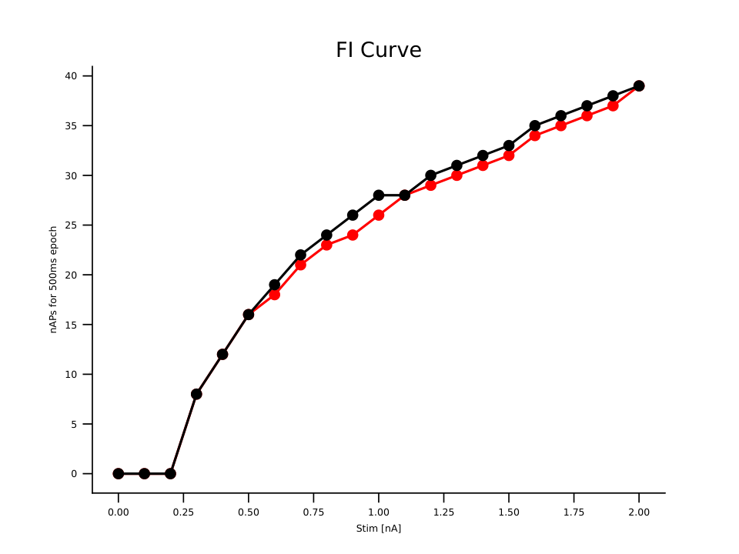
mut10_2_na12-2.0_na16-2

Slide 7


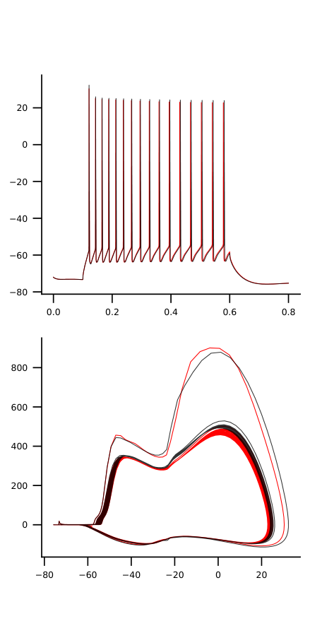
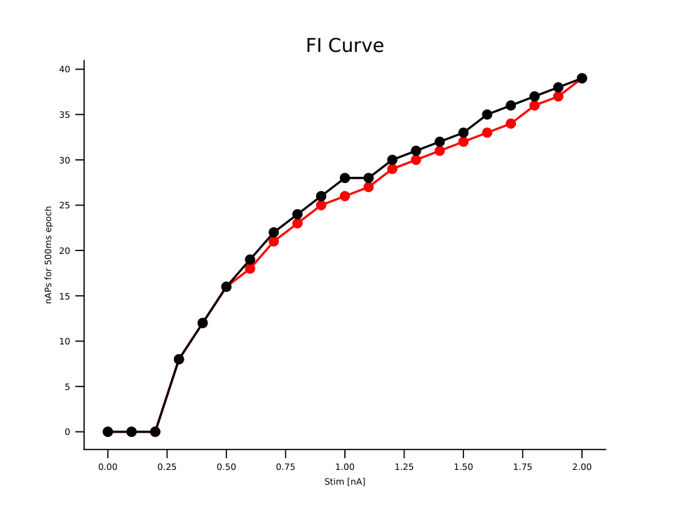
mut10_2_na12-2.25_na16-2

Slide 8


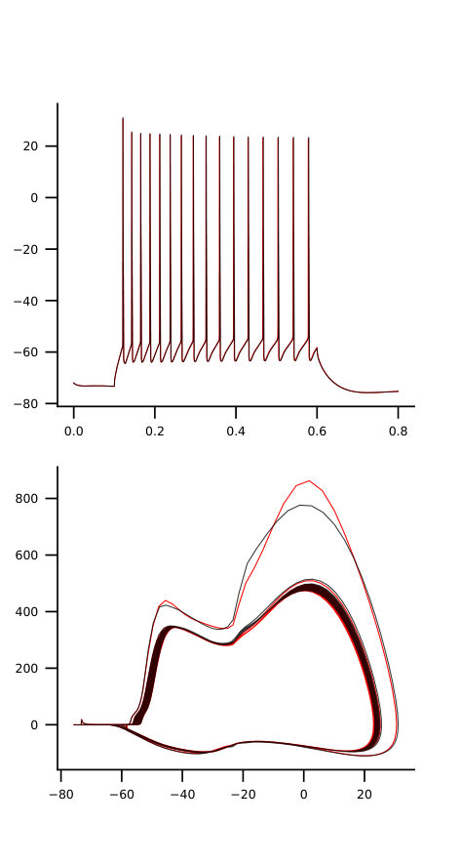

mut10_3_na12-1.75_na16-2

Slide 9


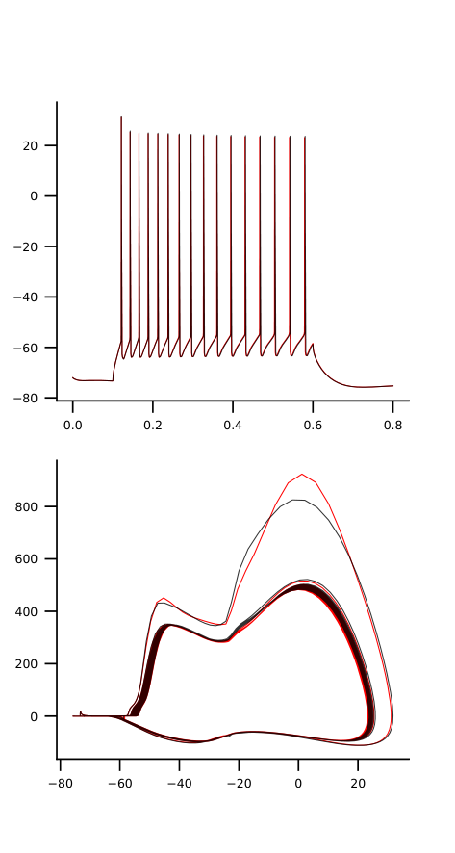

mut10_3_na12-2.0_na16-2

Slide 10
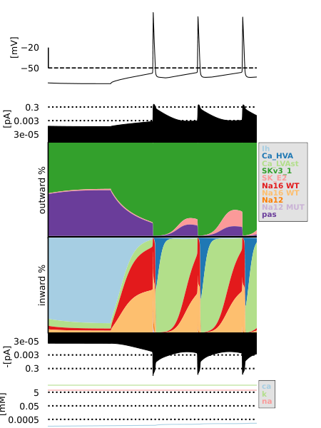

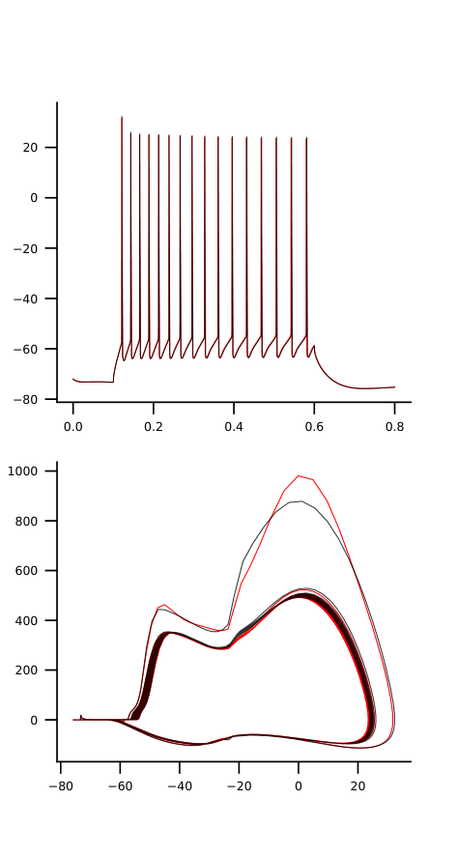
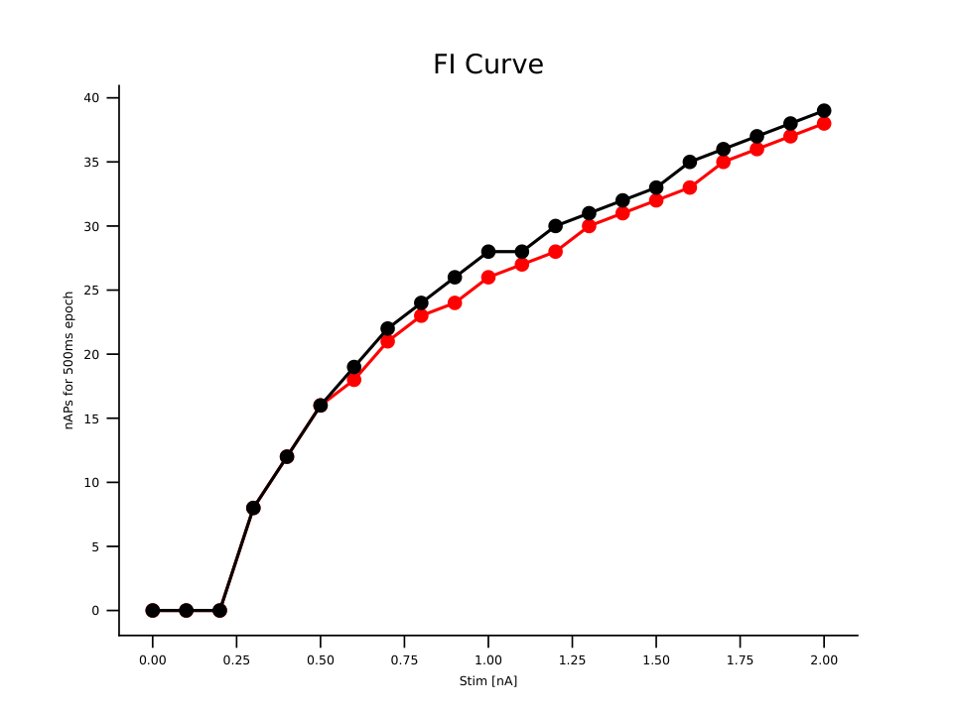
mut10_3_na12-2.25_na16-2

Slide 11




mut10_4_na12-1.75_na16-2

Slide 12




mut10_4_na12-2.0_na16-2

Slide 13




mut10_4_na12-2.25_na16-2

Slide 14




mut11_1_na12-1.75_na16-2

Slide 15




mut11_1_na12-2.0_na16-2

Slide 16




mut11_1_na12-2.25_na16-2

Slide 17
mut11_2_na12-1.75_na16-2

Slide 18
mut11_2_na12-2.0_na16-2

Slide 19
mut11_2_na12-2.25_na16-2

Slide 20




mut11_3_na12-1.75_na16-2

Slide 21



mut11_3_na12-2.0_na16-2

Slide 22




mut11_3_na12-2.25_na16-2

Slide 23
mut11_4_na12-1.75_na16-2

Slide 24
mut11_4_na12-2.0_na16-2

Slide 25
mut11_4_na12-2.25_na16-2

Slide 26


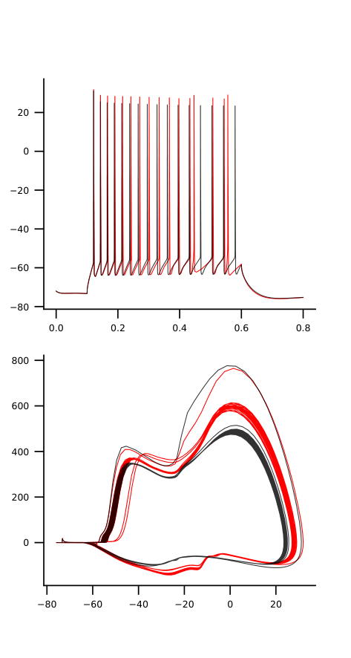
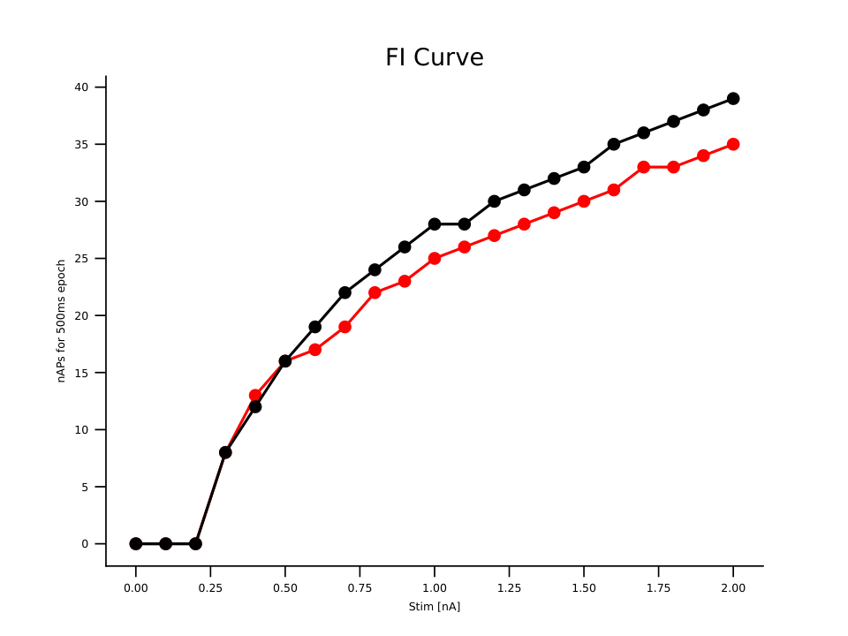
mut12_1_na12-1.75_na16-2

Slide 27
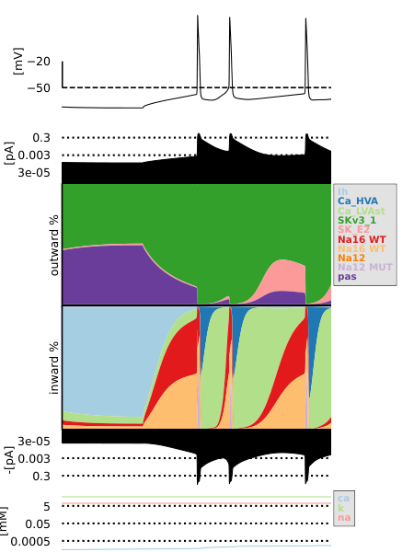
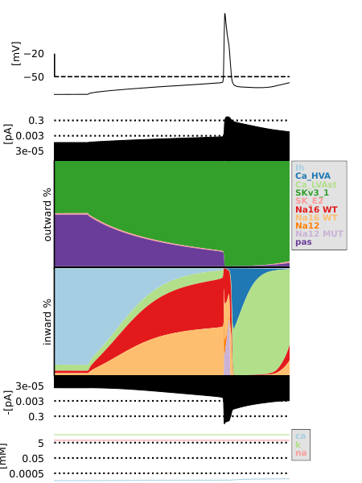
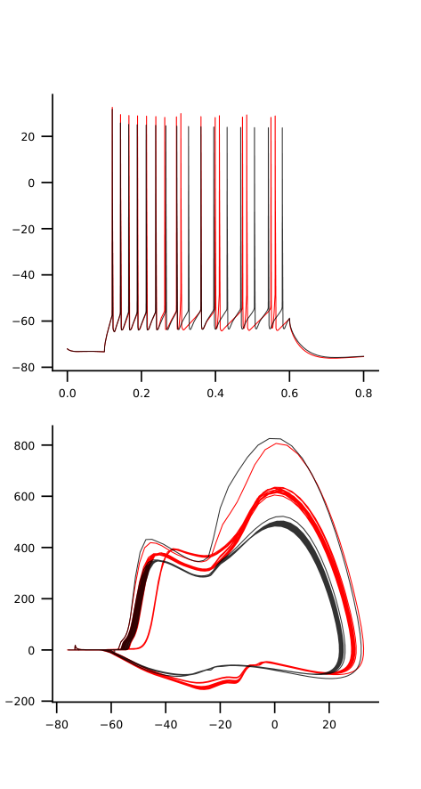
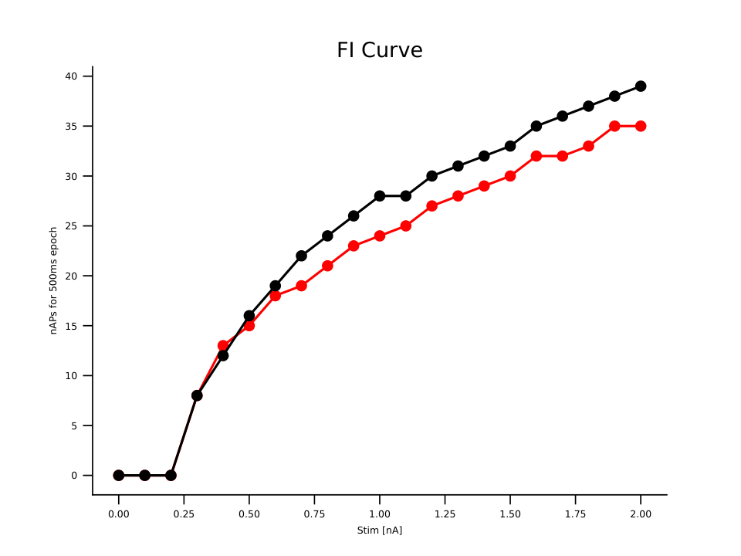
mut12_1_na12-2.0_na16-2

Slide 28
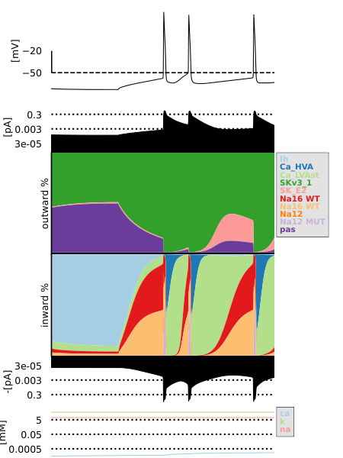
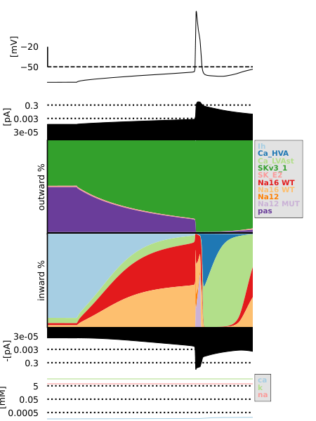
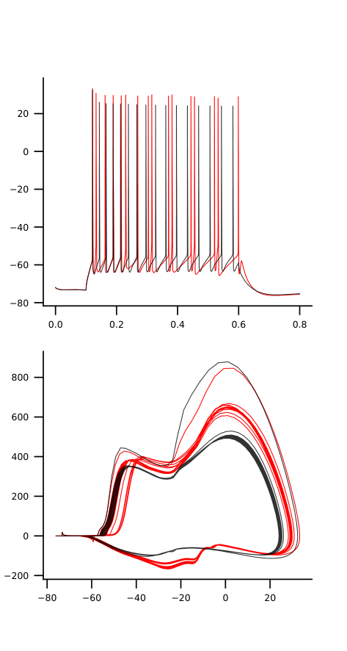
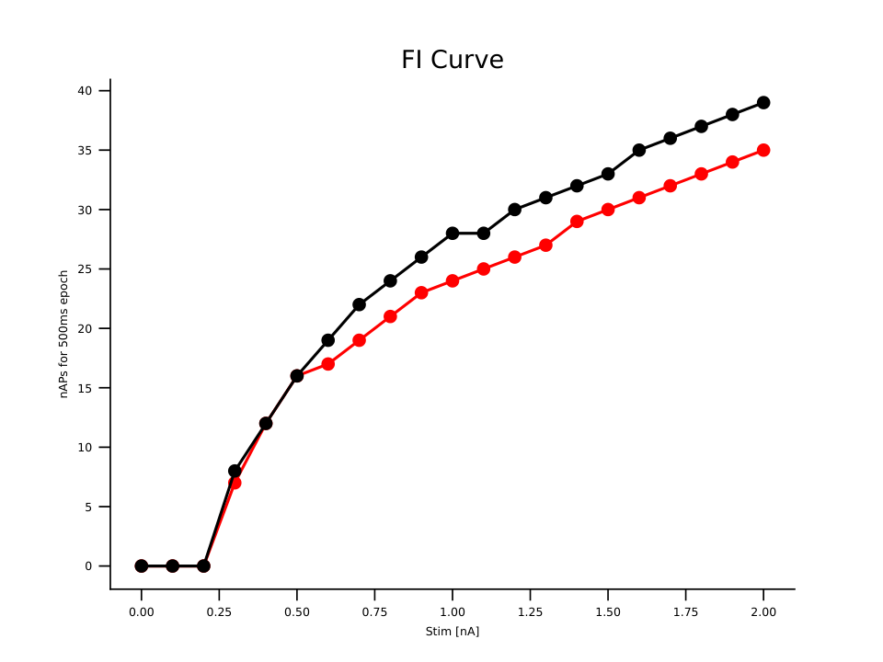
mut12_1_na12-2.25_na16-2

Slide 29
mut12_2_na12-1.75_na16-2

Slide 30
mut12_2_na12-2.0_na16-2

Slide 31
mut12_2_na12-2.25_na16-2

Slide 32


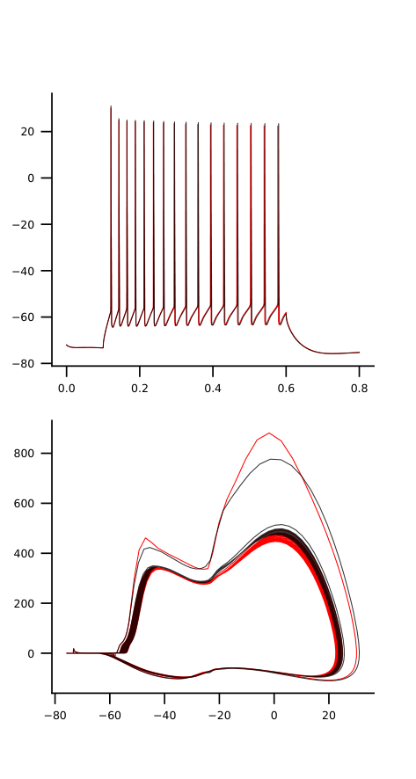

mut12_3_na12-1.75_na16-2

Slide 33



mut12_3_na12-2.0_na16-2

Slide 34




mut12_3_na12-2.25_na16-2

Slide 35




mut12_4_na12-1.75_na16-2

Slide 36



mut12_4_na12-2.0_na16-2

Slide 37




mut12_4_na12-2.25_na16-2

Slide 38
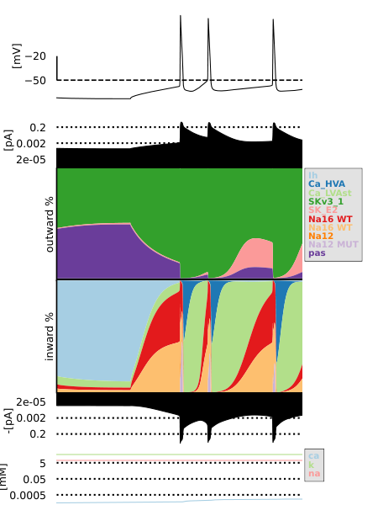

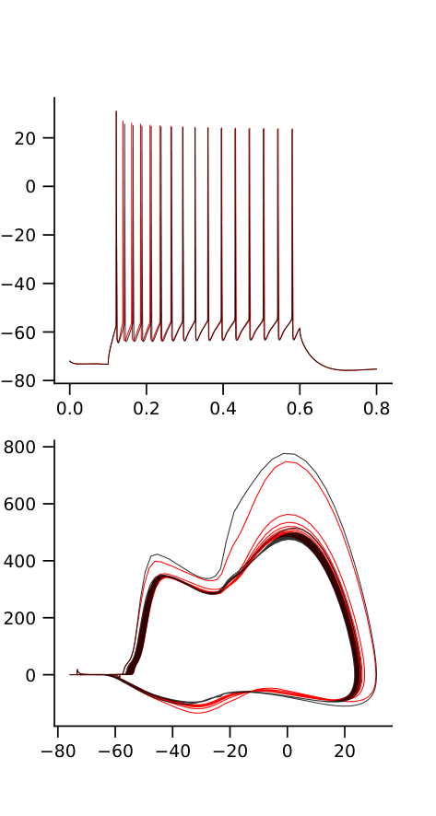
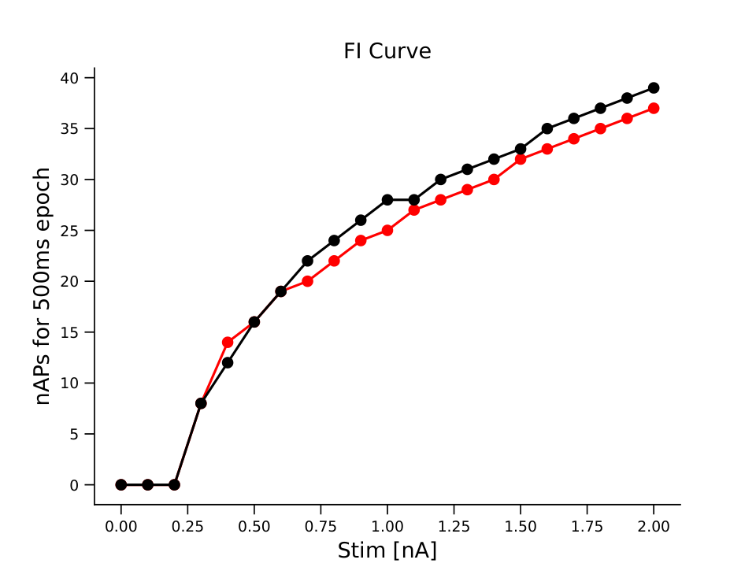
mut2_1_na12-1.75_na16-2

Slide 39


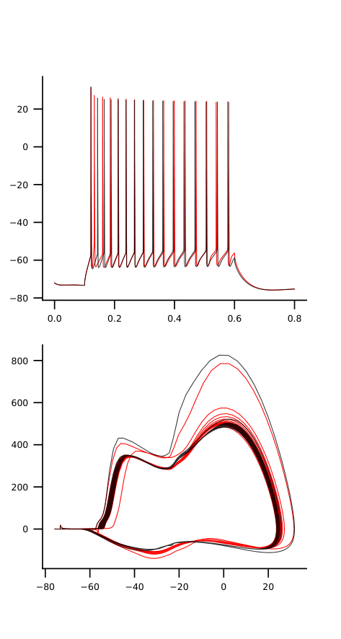

mut2_1_na12-2.0_na16-2

Slide 40


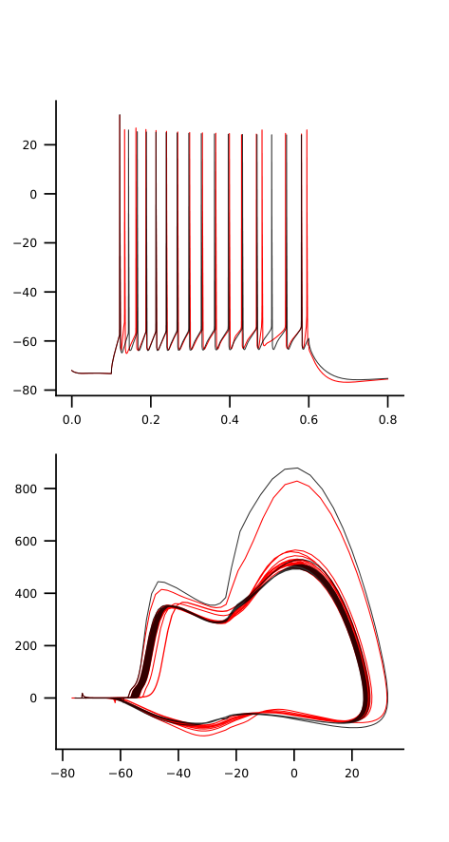
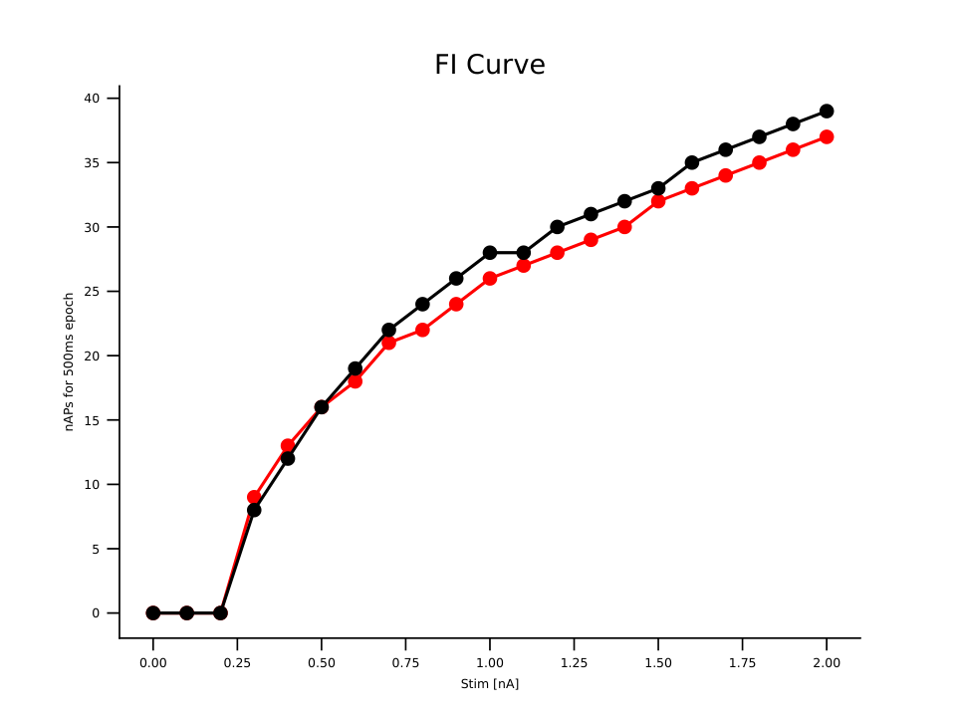
mut2_1_na12-2.25_na16-2

Slide 41



mut2_2_na12-1.75_na16-2

Slide 42



mut2_2_na12-2.0_na16-2

Slide 43



mut2_2_na12-2.25_na16-2

Slide 44


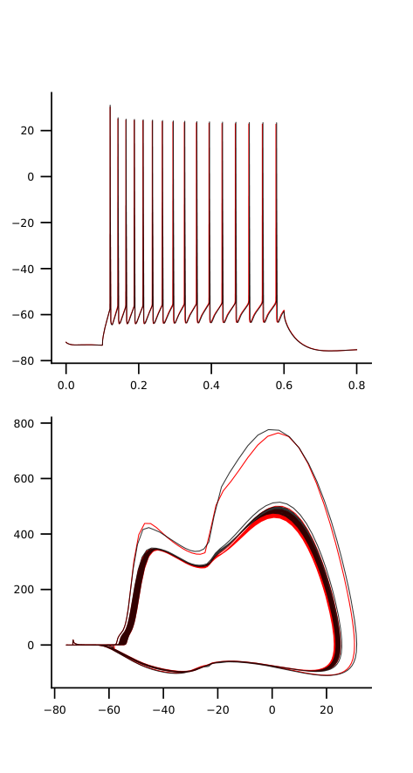
mut2_3_na12-1.75_na16-2

Slide 45




mut2_3_na12-2.0_na16-2

Slide 46




mut2_3_na12-2.25_na16-2

Slide 47




mut2_4_na12-1.75_na16-2

Slide 48




mut2_4_na12-2.0_na16-2

Slide 49




mut2_4_na12-2.25_na16-2

Slide 50




mut3_1_na12-1.75_na16-2

Slide 51



mut3_1_na12-2.0_na16-2

Slide 52



mut3_1_na12-2.25_na16-2

Slide 53




mut3_2_na12-1.75_na16-2

Slide 54




mut3_2_na12-2.0_na16-2

Slide 55


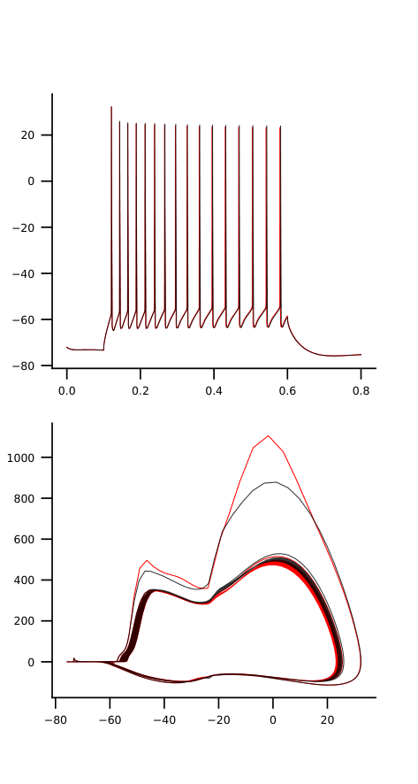

mut3_2_na12-2.25_na16-2

Slide 56



mut3_3_na12-1.75_na16-2

Slide 57



mut3_3_na12-2.0_na16-2

Slide 58



mut3_3_na12-2.25_na16-2

Slide 59



mut3_4_na12-1.75_na16-2

Slide 60



mut3_4_na12-2.0_na16-2

Slide 61



mut3_4_na12-2.25_na16-2

Slide 62


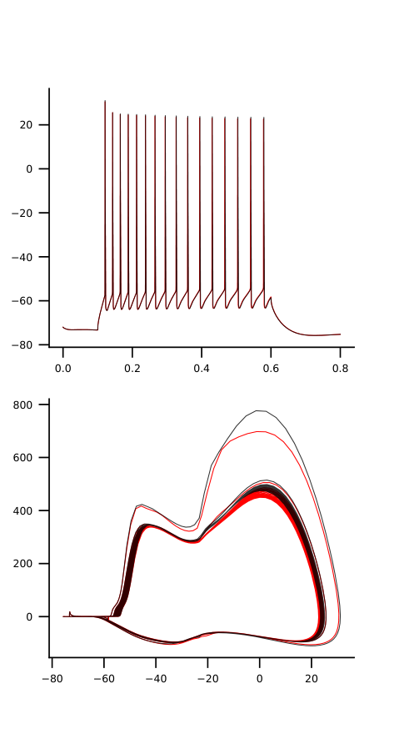
mut4_1_na12-1.75_na16-2

Slide 63


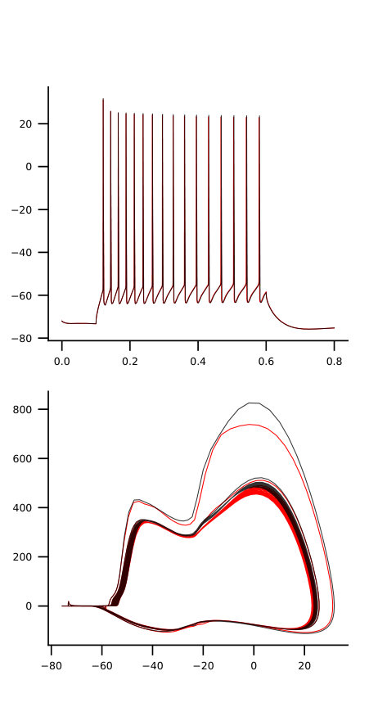

mut4_1_na12-2.0_na16-2

Slide 64


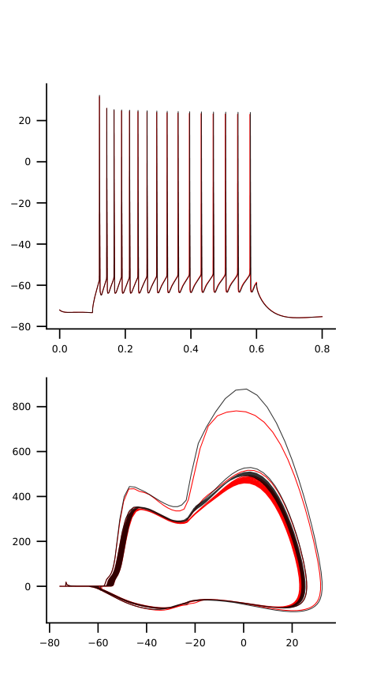
mut4_1_na12-2.25_na16-2

Slide 65




mut4_2_na12-1.75_na16-2

Slide 66


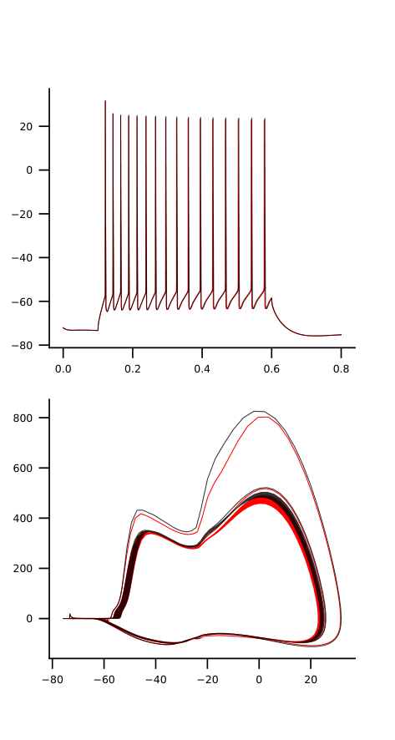

mut4_2_na12-2.0_na16-2

Slide 67


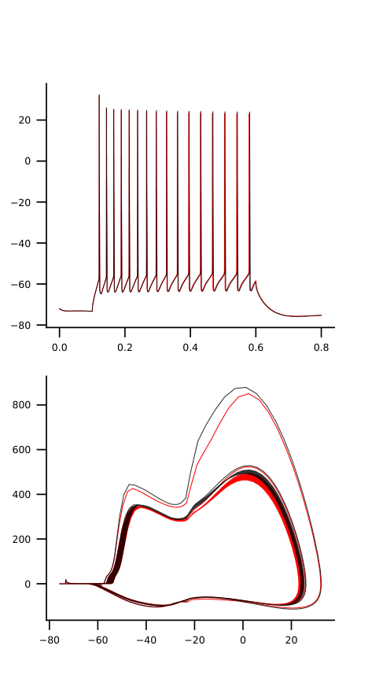

mut4_2_na12-2.25_na16-2

Slide 68



mut4_3_na12-1.75_na16-2

Slide 69



mut4_3_na12-2.0_na16-2

Slide 70



mut4_3_na12-2.25_na16-2

Slide 71


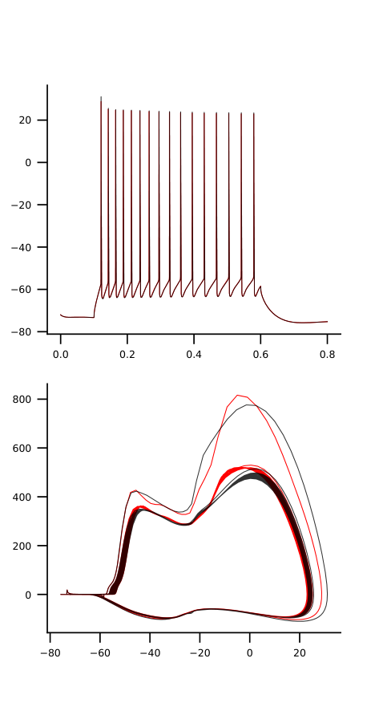

mut4_4_na12-1.75_na16-2

Slide 72


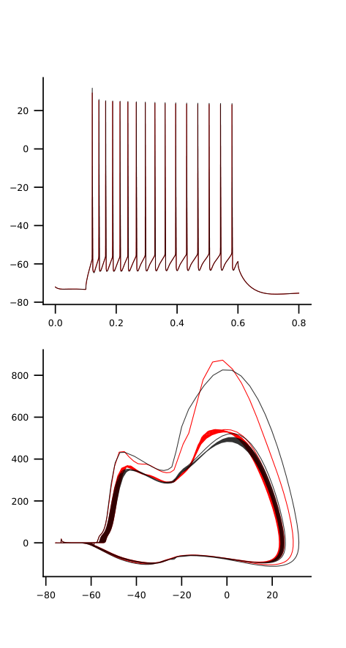

mut4_4_na12-2.0_na16-2

Slide 73


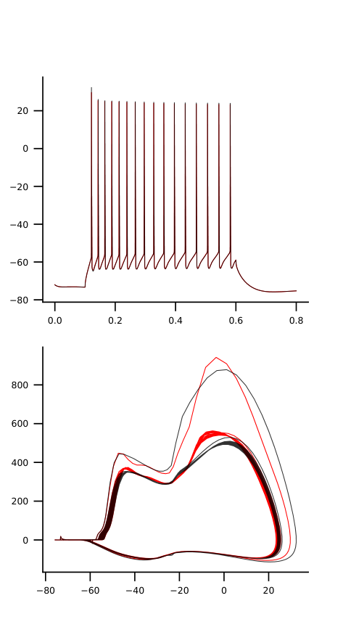

mut4_4_na12-2.25_na16-2

Slide 74




mut5_1_na12-1.75_na16-2

Slide 75




mut5_1_na12-2.0_na16-2

Slide 76




mut5_1_na12-2.25_na16-2

Slide 77




mut5_2_na12-1.75_na16-2

Slide 78




mut5_2_na12-2.0_na16-2

Slide 79




mut5_2_na12-2.25_na16-2

Slide 80


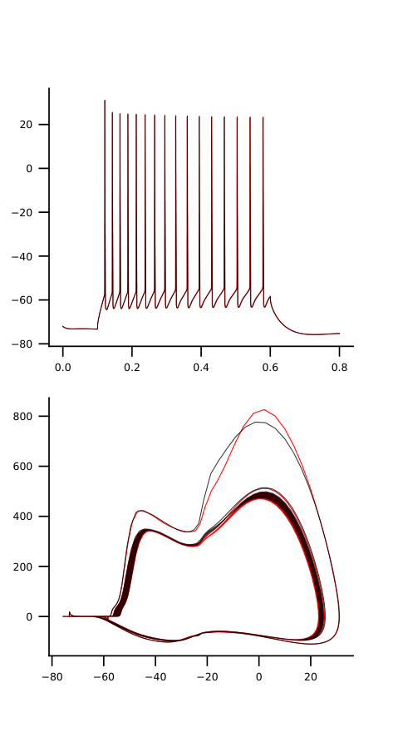
mut5_3_na12-1.75_na16-2

Slide 81



mut5_3_na12-2.0_na16-2

Slide 82


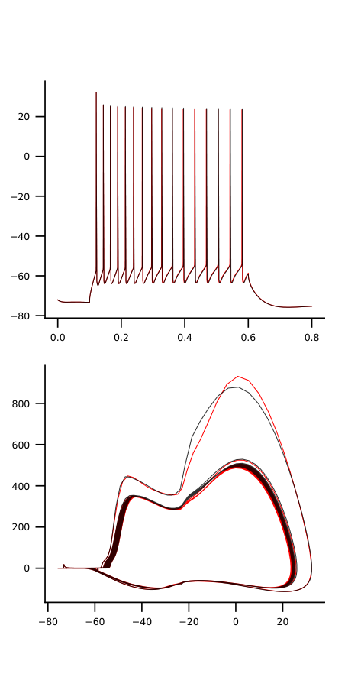

mut5_3_na12-2.25_na16-2

Slide 83



mut5_4_na12-1.75_na16-2

Slide 84




mut5_4_na12-2.0_na16-2

Slide 85




mut5_4_na12-2.25_na16-2

Slide 86



mut6_1_na12-1.75_na16-2

Slide 87



mut6_1_na12-2.0_na16-2

Slide 88



mut6_1_na12-2.25_na16-2

Slide 89



mut6_2_na12-1.75_na16-2

Slide 90



mut6_2_na12-2.0_na16-2

Slide 91



mut6_2_na12-2.25_na16-2

Slide 92




mut6_3_na12-1.75_na16-2

Slide 93




mut6_3_na12-2.0_na16-2

Slide 94


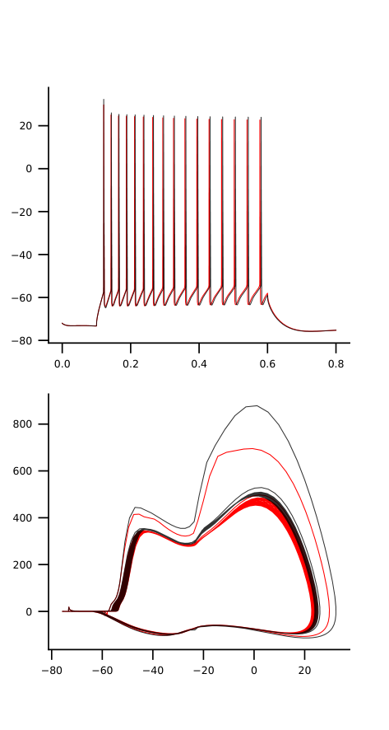
mut6_3_na12-2.25_na16-2

Slide 95



mut6_4_na12-1.75_na16-2

Slide 96



mut6_4_na12-2.0_na16-2

Slide 97




mut6_4_na12-2.25_na16-2

Slide 98



mut7_1_na12-1.75_na16-2

Slide 99



mut7_1_na12-2.0_na16-2

Slide 100



mut7_1_na12-2.25_na16-2

Slide 101



mut7_2_na12-1.75_na16-2

Slide 102


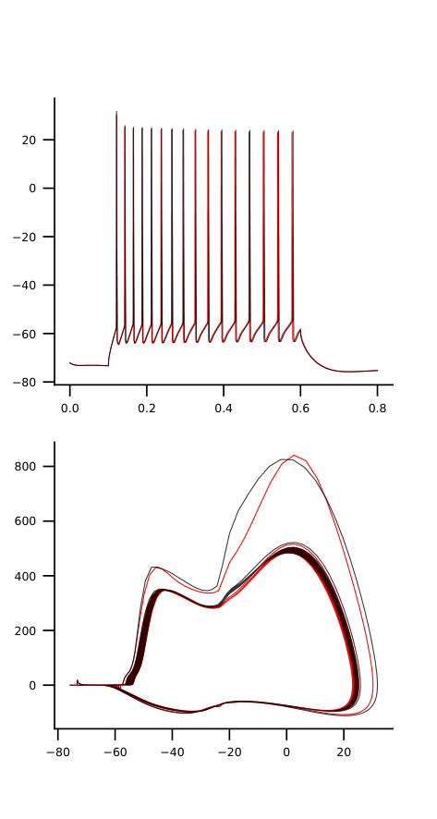

mut7_2_na12-2.0_na16-2

Slide 103



mut7_2_na12-2.25_na16-2

Slide 104


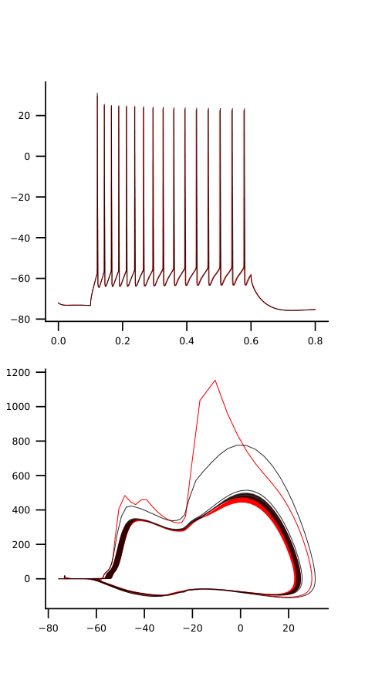
mut7_3_na12-1.75_na16-2

Slide 105


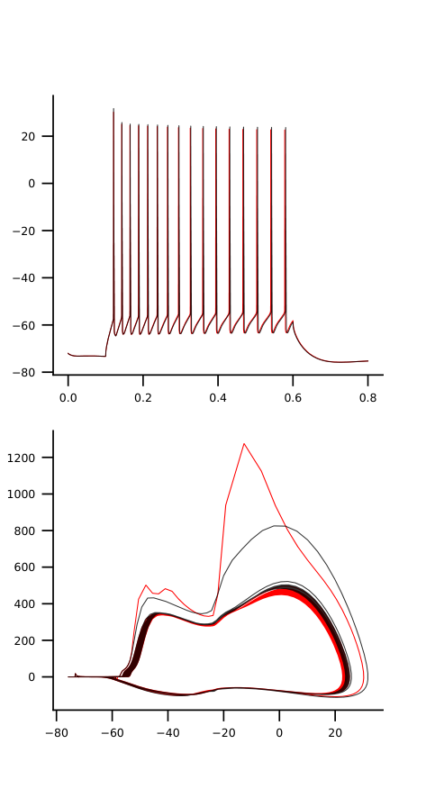
mut7_3_na12-2.0_na16-2

Slide 106



mut7_3_na12-2.25_na16-2

Slide 107




mut7_4_na12-1.75_na16-2

Slide 108



mut7_4_na12-2.0_na16-2

Slide 109



mut7_4_na12-2.25_na16-2

Slide 110




mut8_1_na12-1.75_na16-2

Slide 111



mut8_1_na12-2.0_na16-2

Slide 112



mut8_1_na12-2.25_na16-2

Slide 113
mut8_2_na12-1.75_na16-2

Slide 114
mut8_2_na12-2.0_na16-2

Slide 115
mut8_2_na12-2.25_na16-2

Slide 116
mut8_3_na12-1.75_na16-2

Slide 117
mut8_3_na12-2.0_na16-2

Slide 118
mut8_3_na12-2.25_na16-2

Slide 119
mut8_4_na12-1.75_na16-2

Slide 120
mut8_4_na12-2.0_na16-2

Slide 121
mut8_4_na12-2.25_na16-2

Slide 122
mut9_1_na12-1.75_na16-2

Slide 123
mut9_1_na12-2.0_na16-2

Slide 124
mut9_1_na12-2.25_na16-2

Slide 125
mut9_2_na12-1.75_na16-2

Slide 126
mut9_2_na12-2.0_na16-2

Slide 127
mut9_2_na12-2.25_na16-2

Slide 128
mut9_3_na12-1.75_na16-2

Slide 129
mut9_3_na12-2.0_na16-2

Slide 130
mut9_3_na12-2.25_na16-2

Slide 131
mut9_4_na12-1.75_na16-2

Slide 132
mut9_4_na12-2.0_na16-2

Slide 133
mut9_4_na12-2.25_na16-2

